Slide 1


Slide 2
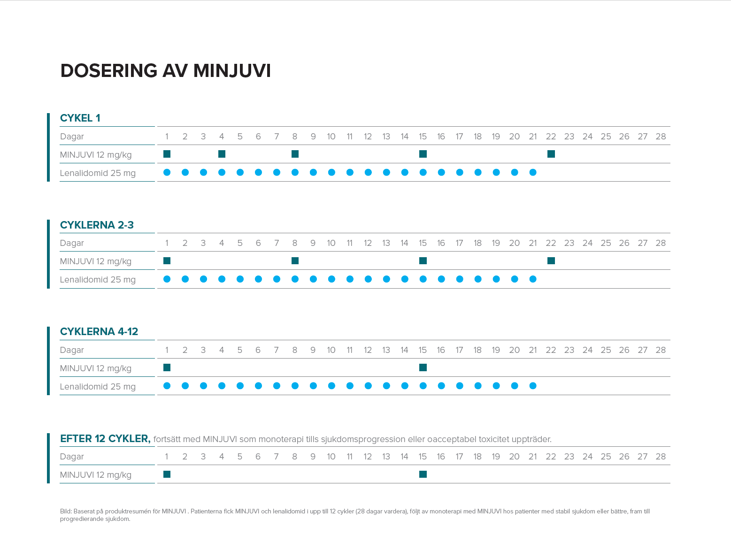

Slide 3
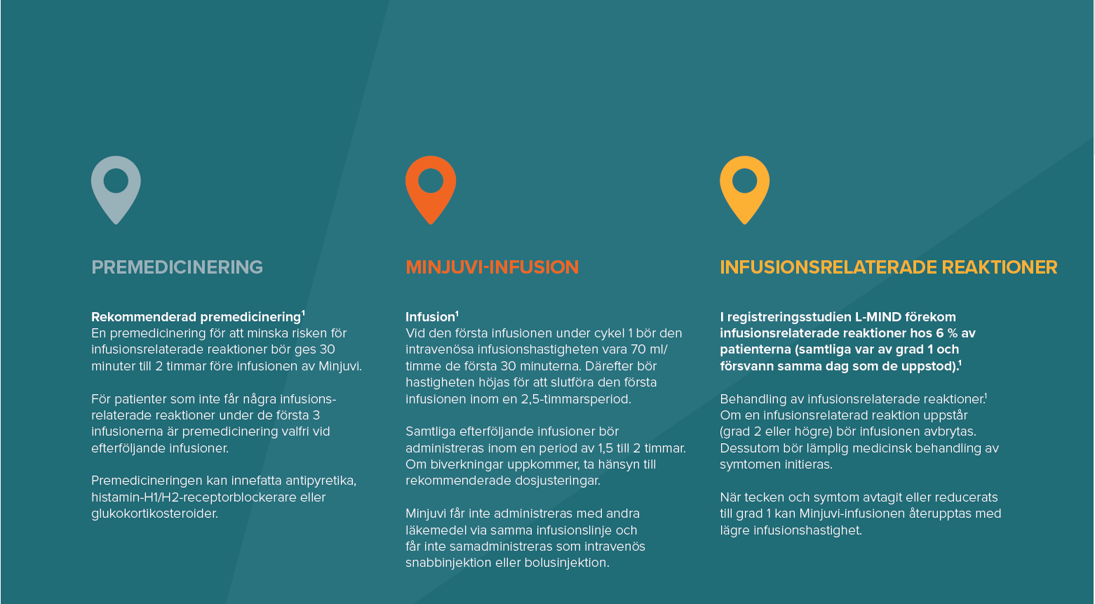

Slide 4
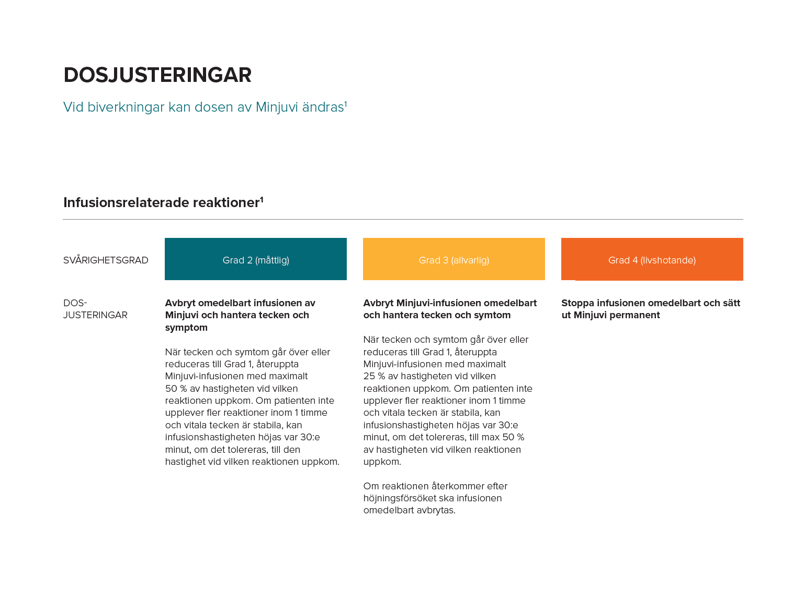

Slide 5
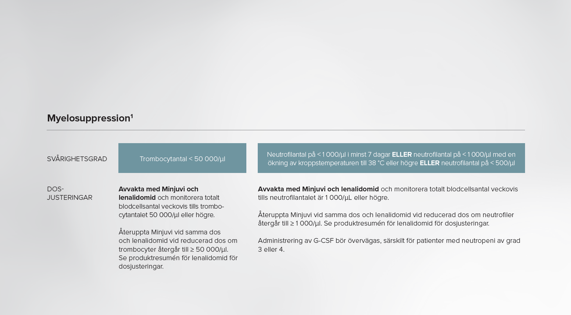

Slide 6


Slide 7


Slide 8
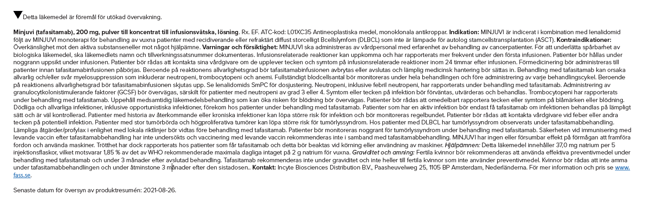
Indication: Minjuvi® is a CD19 directed Fc-enhanced antibody indicated in combination with lenalidomide followed by Minjuvi monotherapy for the treatment of adult patients with relapsed or refractory diffuse large B-cell lymphoma (DLBCL), including DLBCL arising from low grade lymphoma, and who are not eligible for, or refuse autologous stem cell transplant (ASCT).
1. Minjuvi Summary of Product Characteristics, October 2021
SE/OTHR/P/21/0013, November 2021

